Slide 1

Bristol-Myers Squibb
Artificial Intelligence: Skeletal Formula Recognition

Slide 2




“To our patients and customers We commit to scientific excellence and investment in biopharmaceutical research and development to provide innovative, high-quality medicines that address the unmet medical needs of patients with serious diseases. We apply scientific rigor to produce clinical and economic benefit through medicines that improve patients’ lives. We strive to make information about our commercialized medicines widely and readily available. We actively seek to improve access to care, advocate for policies that promote health equity, and help underserved patients access and afford the medicines they need.”
Mission
“To discover, develop and deliver innovative medicines that help patients prevail over serious diseases”
Vision
“To be the world’s leading biopharma company that transforms patients’ lives through science”
Values
Integrity, Urgency, accountability, Innovation, Passion, Inclusion

Slide 3
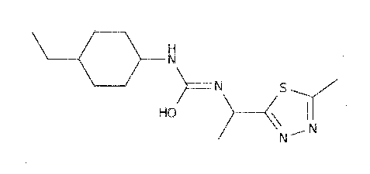
Image Recognition: Skeletal Compound Recognition Using AI

Slide 4
Handwritten Skeletal Compounds Issues and History
International Chemical Identifier (InChI) – Released April 15th, 2005
“The InChI and InChIKey have become essential tools for scientists worldwide, providing a new Common Language for Chemistry. The power of these tools allows chemists and computers to communicate more effectively thereby accelerating the pace of scientific research.” (iupac.org)
Before InChI was released, all handwritten research was scanned into documents with no InChI key associated with it. Leaving a gap in research accessibility, there is a substantial chance that research may already exist, saving time and resources.
Building and training a Convolutional Neural Network(CNN) can result in a model that can perform image recognition on pre-2005 research documents, resulting in more precise investment for future research.

Slide 5
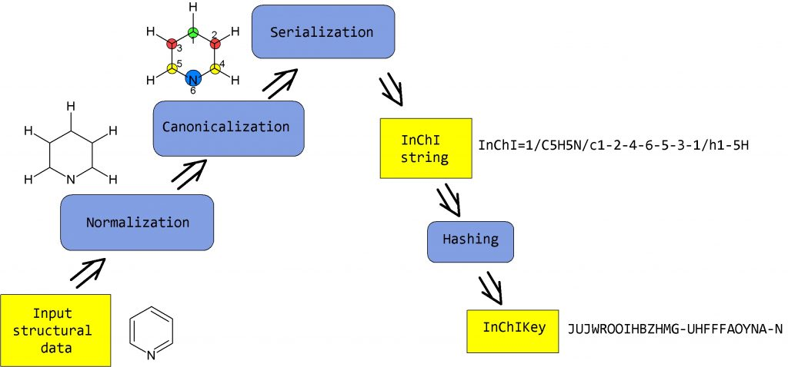
How does InChI Work?
Using our CNN on a training data set split from BMS’ data set, low resolution images can be recognized.
The image can then be processed using InChI/Key Generation, demonstrated on the iupac.org website.
This will expedite the processing of 30+ years of nomenclature that has not been inventoried into InChI databases
Bristol-Myers Squibb Database
General Workflow of InChI/Key generation (iupac.org)

Slide 6
Assumptions
All work done will be cross platform compatible and pushed to private Github account, all commits approved by team leaders.
All team members will have hardware capable of data manipulation and required tasks for their phase.
All images in data are clean scans with high resolution
All images in testing and training sets will have matching InChI labels

Slide 7
Constraints
Approval required not only from BMS but from InChI community as well.
Universal knowledge across all teams involved in project.
All funds will be dispersed according to current phase of project.
Further iterations of model training will require extra funding only approved in congruence with stakeholders and domain experts.
Stakeholders have set target goal of 90% accuracy in model testing.
Equipment will need to have updated platforms with a minimum of 8gb of RAM, 4gb Graphics cards and 16 core processors. Funding has been allocated to accommodate out of date systems.

Slide 8
Considerations
The main consideration in this project is the potential for iteration
BMS will be giving a large sum of resources to this project, timely results are expected with hopes of running ahead of schedule in preparation of possible reiteration of model training.
Legal considerations are expected as with any biopharmaceutical company giving advancements.
AI will need to be checked thoroughly for accuracy before any medications or therapies are created.

Slide 9
The Biopharmaceutical Market
The global biopharmaceuticals market accounted for $186,470 million in 2017, and is projected to reach $526,008 million by 2025, registering a CAGR of 13.8% from 2018 to 2025 (https://www.alliedmarketresearch.com/biopharmaceutical-market)
Getting ahead of the curve on this dramatic increase in a short 7 years is a primary goal of BMS.
The ROI on this application could be covered in this time frame, covering most costs and gauged by time saved in reaserch.

Slide 10
KPI’s Involved
KPI’s to be used are the summarized accuracy of the image recognitions software.
Additionally success will be measured by the amount of validated processed images.
Domain experts will have a direct hand on these experiences.
Reaching an accuracy level of 90% error free will deem success for models trained.

Slide 11
What is expected?
In conclusion Bristol-Myers Squibb is expecting full success of this project resulting in a user-friendly research tool that can search for prior research.
There will be three phases:
Further updating and oversight will continuously be performed by BMS in-house staff (No time limit)
Phase 1: Business Understanding
- 2 Weeks
Phase 2: Data Cleansing and Mining
- 8 Weeks
Phase 3: Deployment
- 2 Weeks Minimum

